Slide 1

Swing and MVC
MVC Concepts
ComboBox Model
Table Model

Slide 2

See Also
http://c2.com/cgi/wiki?ModelViewController
https://docs.oracle.com/javase/tutorial/uiswing/components/table.html
Notes:
Some additional information on concurrency

Slide 3
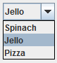
Data in the Component
JComboBox
Map<User, Set<Food>>
add(“Spinach”)
Spinach
List of Strings
add(“Jello”)
Jello
selected(“Jello”)
Pizza

Slide 4
External Data Model
Map<User, Set<Food>>
JComboBox
How many?
What is number 2?
1st is requested.
Which is selected?
Model
Spinach
Jello
3rd is now selected.
Add “Chips” to the list.
Pizza

Slide 5
ComboBoxModel<?>
class FoodModel implements ComboBoxModel<String> {
public int getSize() {}
public String getElementAt(int index) {}
public Object getSelectedItem() {}
public void setSelectedItem(Object anItem) {}
public void addListDataListener(ListDataListener n) {}
public void removeListDataListener(ListDataListener n) {}
}

Slide 6
FoodModel
class FoodModel implements ComboBoxModel<String> {
@Override
public int getSize() {
System.out.println("getSize");
return 3;
}
@Override
public String getElementAt(int index) {
System.out.println("getElementAt("+index+")");
switch(index) {
case 0:
return "Spinach";
case 1:
return "Cake";
case 2:
return "Pizza";
}
return "Should not be here.";
}
public void setSelectedItem(Object anItem) {
System.out.println("setSelectedObject:"+anItem+":");
}
public void addListDataListener(ListDataListener l) {
System.out.println("addListDataListener");
}
public void removeListDataListener(ListDataListener l) {
System.out.println("removeListDataListener");
}
@Override
public Object getSelectedItem() {
System.out.println("getSelectedItem");
return "Cake";
}

Slide 7
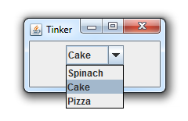
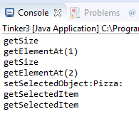
Using the Model
JFrame jf = new JFrame("Tinker");
JPanel pan = new JPanel();
FoodModel fm = new FoodModel();
JComboBox<String> pick = new JComboBox<String>(fm);
pan.add(pick);
jf.setContentPane(pan);
jf.setSize(300, 200);
jf.setVisible(true);
jf.setDefaultCloseOperation(JFrame.EXIT_ON_CLOSE);

Slide 8
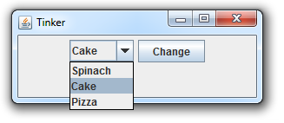
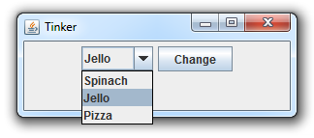
Asynchronous Changes
public String favorite = "Cake";
public ListDataListener listener;
@Override
public String getElementAt(int index) {
switch(index) {
case 0:
return "Spinach";
case 1:
return favorite;
case 2:
return "Pizza";
}
return "Should not be here.";
}
@Override
public void addListDataListener(ListDataListener n) {
listener = n;
}
@Override
public Object getSelectedItem() {
return favorite;
}
FoodModel pm = ...
JButton bt = new JButton("Change");
pan.add(bt);
bt.addActionListener(new ActionListener() {
@Override
public void actionPerformed(ActionEvent e) {
if(pm.favorite.equals("Jello")) {
pm.favorite = "Cake";
} else {
pm.favorite = "Jello";
}
pm.listener.contentsChanged(
new ListDataEvent(pick,
ListDataEvent.CONTENTS_CHANGED,
1,1));
}
});

Slide 9
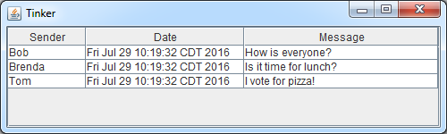
JTable
JFrame jf = new JFrame("Tinker");
JPanel pan = new JPanel(new BorderLayout());
String [] colNames = {"Sender", "Date", "Message"};
Object[][] data = {
{"Bob", new Date(), "How is everyone?"},
{"Brenda", new Date(), "Is it time for lunch?"},
{"Tom", new Date(), "I vote for pizza!"}
};
JTable table = new JTable(data, colNames);
pan.add(new JScrollPane(table), BorderLayout.CENTER);
jf.setContentPane(pan);
jf.setSize(500, 150);
jf.setVisible(true);
jf.setDefaultCloseOperation(JFrame.EXIT_ON_CLOSE);

Slide 10
JTableModel
class ChatTable implements TableModel {
public int getColumnCount() {}
public String getColumnName(int columnIndex) {}
public Class<?> getColumnClass(int columnIndex) {}
public int getRowCount() {}
public Object getValueAt(int rowIndex, int columnIndex) {}
public boolean isCellEditable(int rowIndex, int columnIndex) {}
public void setValueAt(Object aValue, int rowIndex, int columnIndex) {}
public void addTableModelListener(TableModelListener l) {}
public void removeTableModelListener(TableModelListener l) {}
}
How many columns are there?
What is the column header?
What type of data is in the column?
How many rows are there?
What is the value of this cell?
Can the user edit this cell?
User edited this cell.
Notify me of changes.
I no longer need notifications.

Slide 11


Chat Model
class ChatModel implements TableModel {
private CorkBoard board;
private String [] colnames = {"Sender", "Date", "Message"};
public ChatModel(CorkBoard board) {
this.board = board;
}
@Override
public int getColumnCount() {
return 3;
}
@Override
public String getColumnName(int cn) {
return colnames[cn];
}
...
}
He’s Luke’s father !
Who is Darth Vader?

Slide 12

@Override
public Class<?> getColumnClass(int cn) {
if(cn==1) {
return Date.class;
}
return String.class;
}
@Override
public boolean isCellEditable(int arg0, int arg1) {
return false;
}
@Override
public void setValueAt(Object arg0, int arg1, int arg2) {}
@Override
public void addTableModelListener(TableModelListener arg0) {}
@Override
public void removeTableModelListener(TableModelListener arg0) {}

Slide 13
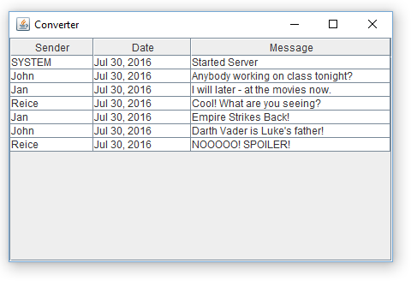
Chat Data
@Override
public int getRowCount() {
try {
List<Message> mess = board.getMessages();
return mess.size();
} catch (RemoteException e) {
throw new RuntimeException(e);
}
}
@Override
public Object getValueAt(int row, int cn) {
try {
List<Message> mess = board.getMessages();
Message m = mess.get(row);
switch(cn) {
case 0:
return m.getSender();
case 1:
return m.getPosted();
}
return m.getMessage();
} catch (RemoteException e) {
throw new RuntimeException(e);
}
}

Slide 14

Much More to JTable
Custom renderers
Custom editors
Column sorting
Column widths
Asynchronous updates

Slide 15
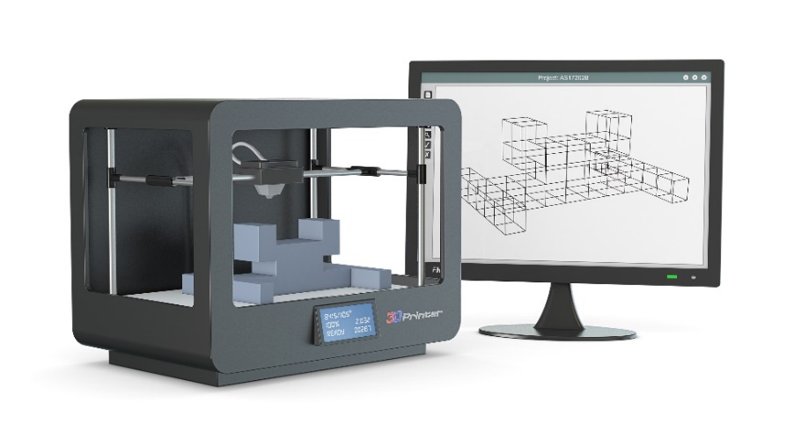
Tinkering
Type in the JTable Chat code.
Add a JTextField for filtering the table.
Try telling the table when the filtering has changed.

